Slide 1

Department of Information Technology
NBA Accredited A.P. Shah Institute of Technology G.B.Road,Kasarvadavli, Thane(W), Mumbai-400615 UNIVERSITY OF MUMBAI Academic Year 2020-2021

Slide 2
A Project Report on Orderista
An AI based food ordering application
Submitted in partial fulfillment of the degree of Bachelor of Engineering(Sem-8) in INFORMATION TECHNOLOGY By Tejas Raibagi(17104067) Ashwin Vishwakarma(17104009) Jahnavi Naik(17104046) ` Under the Guidance of Mrs. Rujata Chaudhari and Mrs. Geetanjali Kalme
M

Slide 3
1.Project Conception and Initiation

Slide 4
1.1 Abstract
The main issue which we came across in our college canteen was that it's not too spacious to accommodate enough students all together having the same lunch time.
Our project “Orderista- An AI based cross platform food ordering system” enables the end user to register online, select the food they plan to have for their lunch from e-menu card and place a order online by just selecting the food that the user wants using android application.
Nowadays people dont have much time to spend in canteen by just waiting there for the waiter to take their order or collect the prepared order. Since this is specific to our college canteen, many students visit the canteen only during their break so they have limited time to eat.
So this software helps them save time and order food and have it wherever they want. The benefit of this is that if there is rush in the canteen then there will always be chances that the food is unavailable or there is no space to have it which using the application will vanish off.
Every student will be able to access via their moodle id and a user generated password, by using which they can log into the system.

Slide 5
1.2 Objectives
To make it convenient for those who have less time.
To allow users to give their orders before hand makes them save time and enables them to eat wherever they like.
To minimise the need to look for space in canteen to have a seat, one could add a pickup location location for their delivery making it to go with some ease.
To avoid complications of cash or inaccurate service.
To save time would be one of the major objective out here.
To make it cost effective as online transactions are just more secure.
To reduce paperwork or manual work.

Slide 6
1.3 Literature Review-1
Paper Title :Canteen Automation System
Authors :Sanil Sharma, Pranchal Jain, Rinshi Jain, Roshni Gupta.
Publication details :Published in fulfillment of degree of BACHELOR OF ENGINEERING in COMPUTER SCIENCE ENGINEERING from Gyan Ganga Institute of Technology and sciences, Jabalpur(M.P) in Dec(2016).
Findings :Canteen Automation system is the system where customers order their food and receive food in the canteen without any delay as they can directly go and collect what they ordered without waiting.The system requires very fewer time factors as compared to manual.The system will provide fast and efficient automated environment instead of slow and error prone manual system.The system will have GUI interface and very less training is required to learn it.
Advantages:Time efficient, user friendly, flexibility.
Disadvantages: Complexity for developing as it follows three tier architecture.

Slide 7
1.3 Literature Review-2
Paper Title :Canteen Automation System
Authors :Monik Shah, Shalin Shah, Mohd Danish Shaikh, Kaustubh Tiwari.
Publication details :International Research Journal of Engineering and Technology (IRJET),
Jan(2018).
Findings :The development of Canteen Automation System involved many phases. The approach used is top-down approach one concentrating on what first, then how and moving to successive levels of details.The first phase started with a detailed study of the problems and prospects of ordering in foods.Completely automated online food ordering process hosted on secure and specials server so no risk of customers getting redirected to server where other websites are listed.
Advantages:Easy maintenance, user friendly, easily accessible, reliable, simple user interface admin panel for creation and configuration of menu,groups and items..
Disadvantages: Requires active internet connection.

Slide 8
1.4 Problem Definition
Problem Identified
The main challenge encountered by our college is that of space being a little less to accommodate all the students at the same time. The experience of ordering food is not quick and a lot of complications while receiving the order. Manual system involves paper work in the form of taking orders maintaining cash which is full of risk and tedious process.
Solution
So this application not only is helping for canteen automation but also solves all of these concerns and makes a lot more easier and feasible atmosphere for every student as well as the manager. Every student will be able to access via their moodle id and a user generated password, by using which they can log into the system.

Slide 9



Technology Stack
1.5 Technology stack
Node.js is an open-source, cross-platform, back-end, JavaScript runtime environment that executes JavaScript code outside a web browser.
Flutter is an open-source UI software development kit created by Google. It is used to develop applications for Android, iOS, Linux, Mac, Windows, Google Fuchsia, and the web from a single codebase.
PostgreSQL, also known as Postgres, is a free and open-source relational database management system emphasizing extensibility and SQL compliance.

Slide 10
1.6 Benefits for environment & Society
Reduced manual labour work which makes it faster
Automated process making it more efficient
No paperwork involved
Major factors namely space and time won’t be compromised

Slide 11
2. Project Design

Slide 12
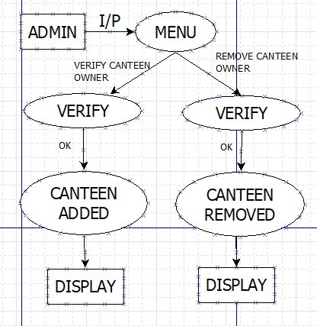
2.1 Proposed System- Admin

Slide 13
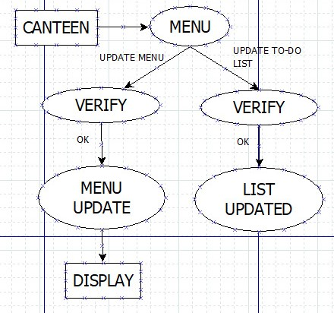
2.1 Proposed System- Canteen Manager

Slide 14
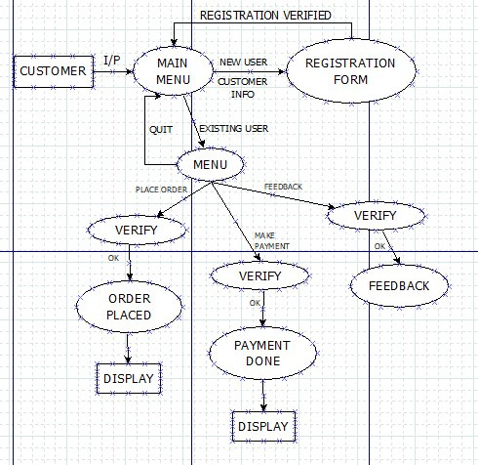
2.1 Proposed System- Customer

Slide 15
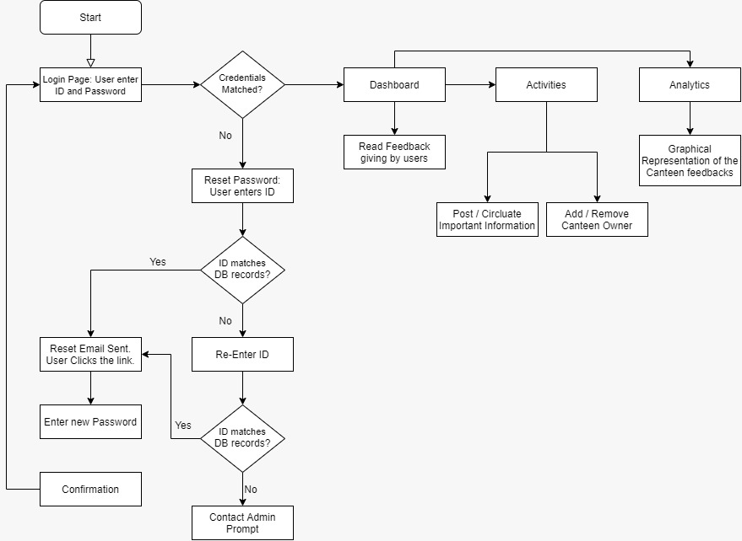
2.2 Design(Admin Portal)

Slide 16
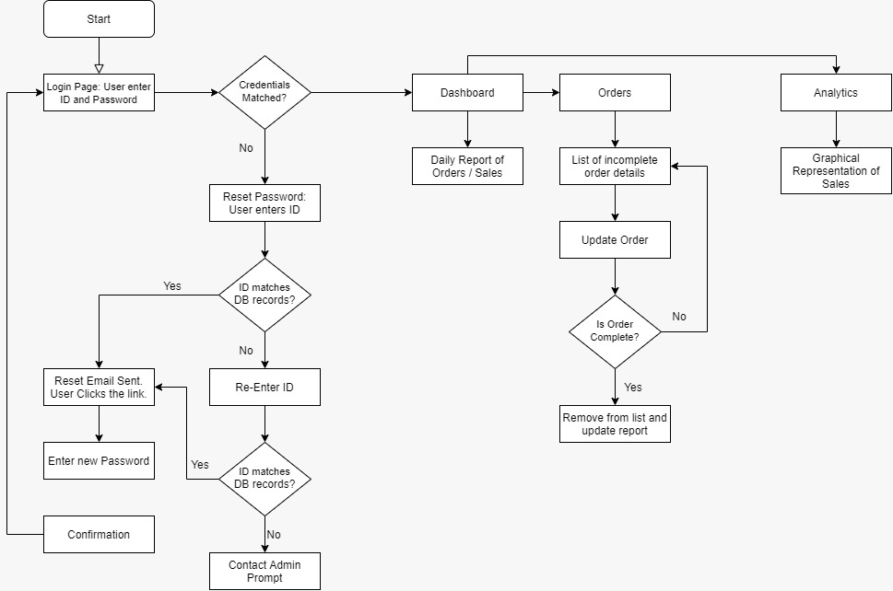
2.2 Design(Canteen manager portal)

Slide 17
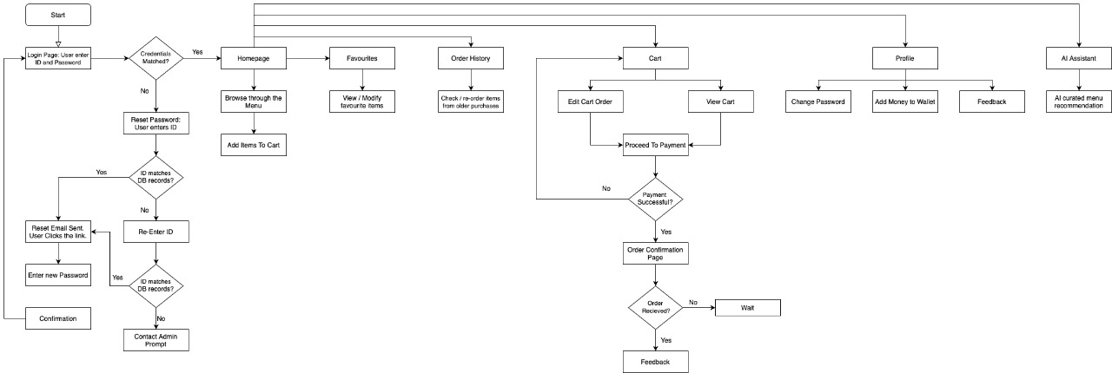
2.2 Design(Customer Portal)

Slide 18
3. Implementation

Slide 19
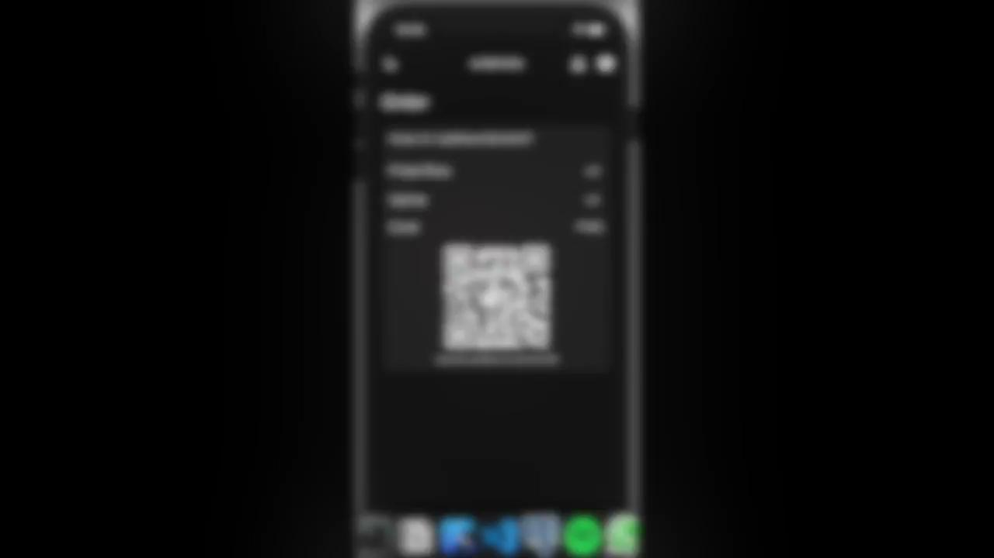

Slide 20
4. Result

Slide 21
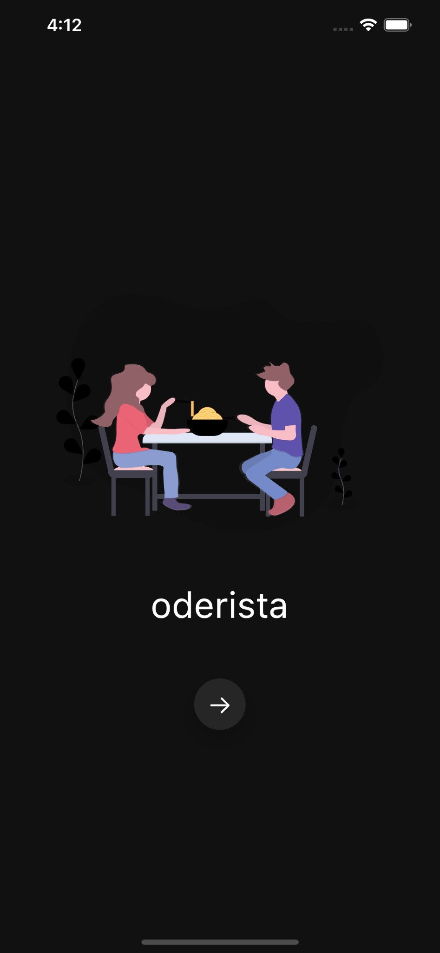
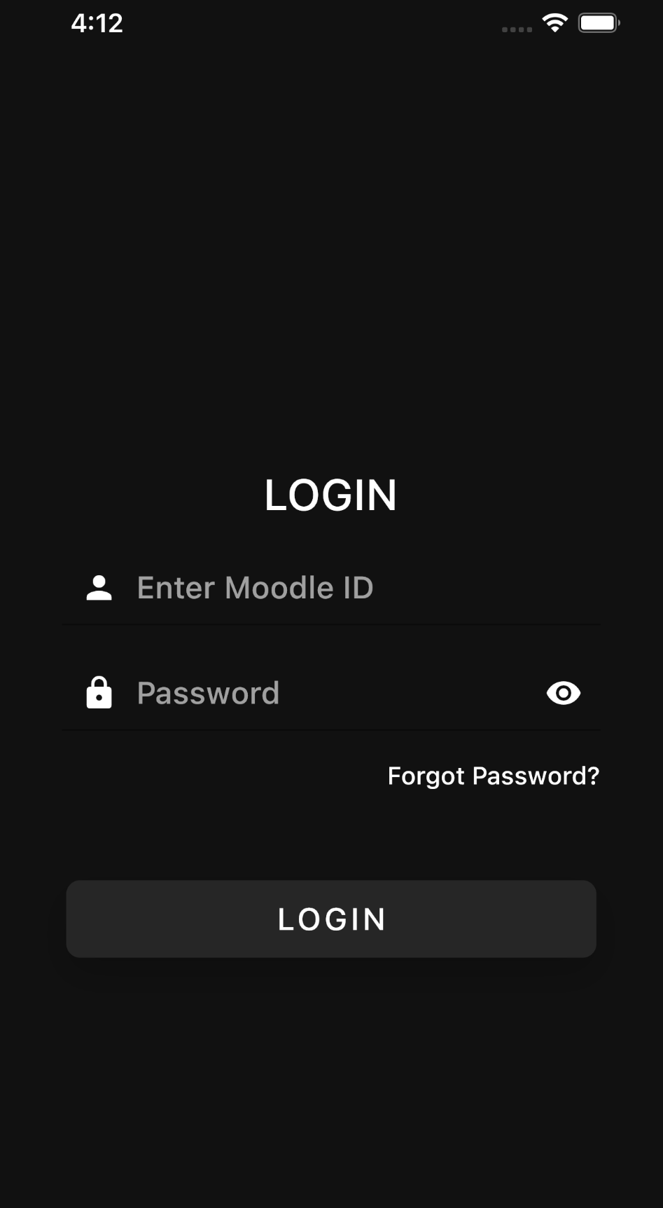
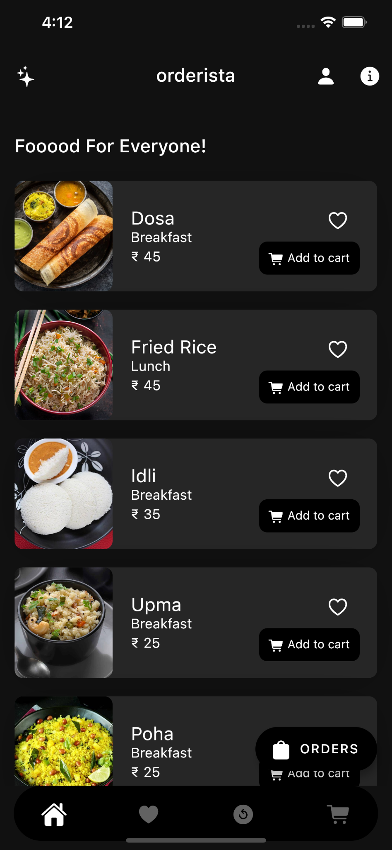
Landing page Login Page Home page

Slide 22
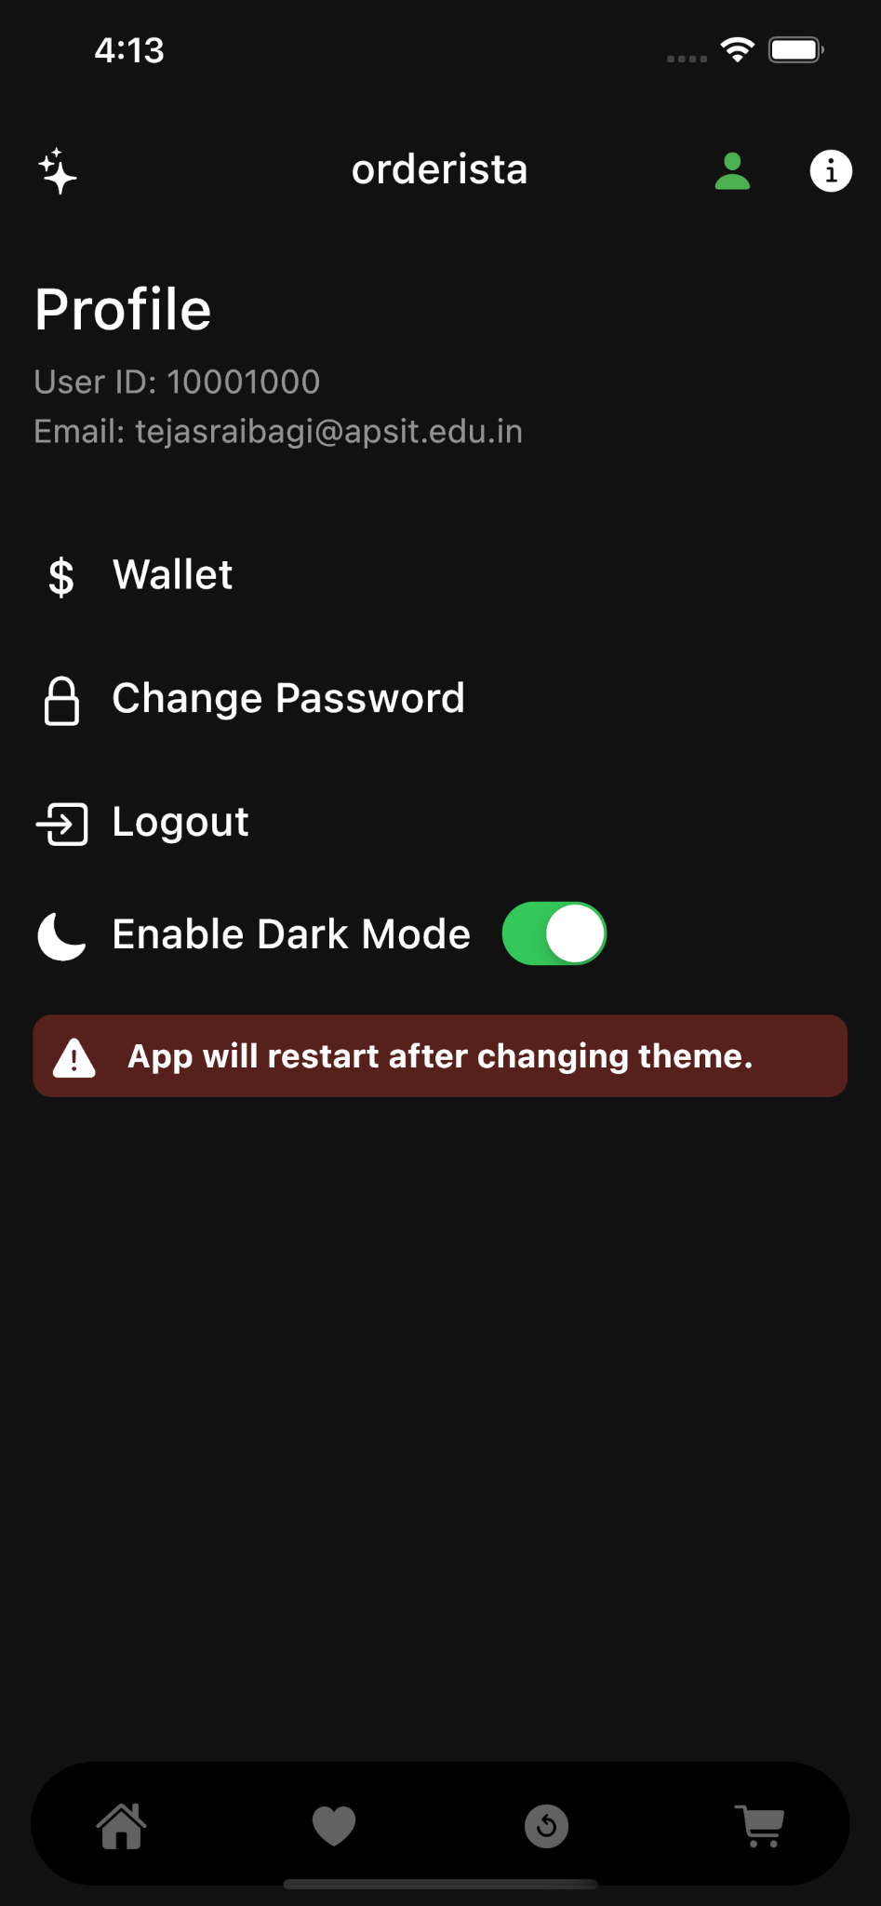
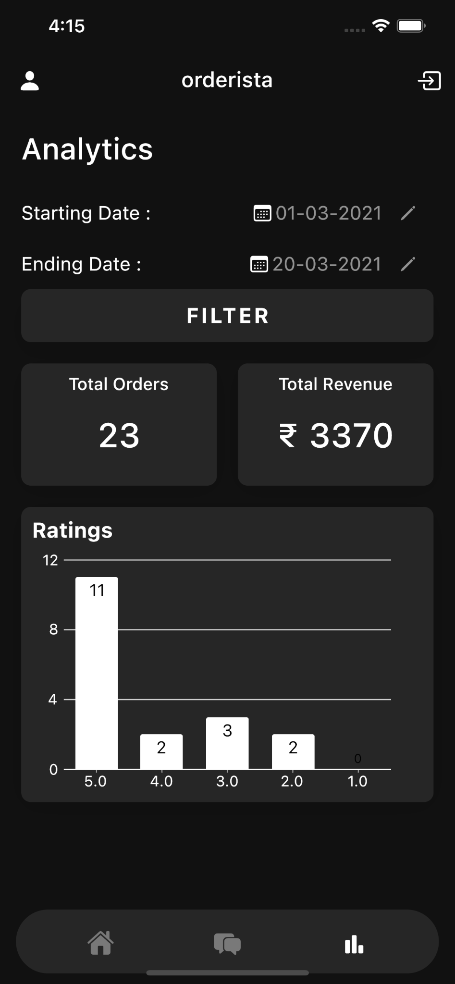
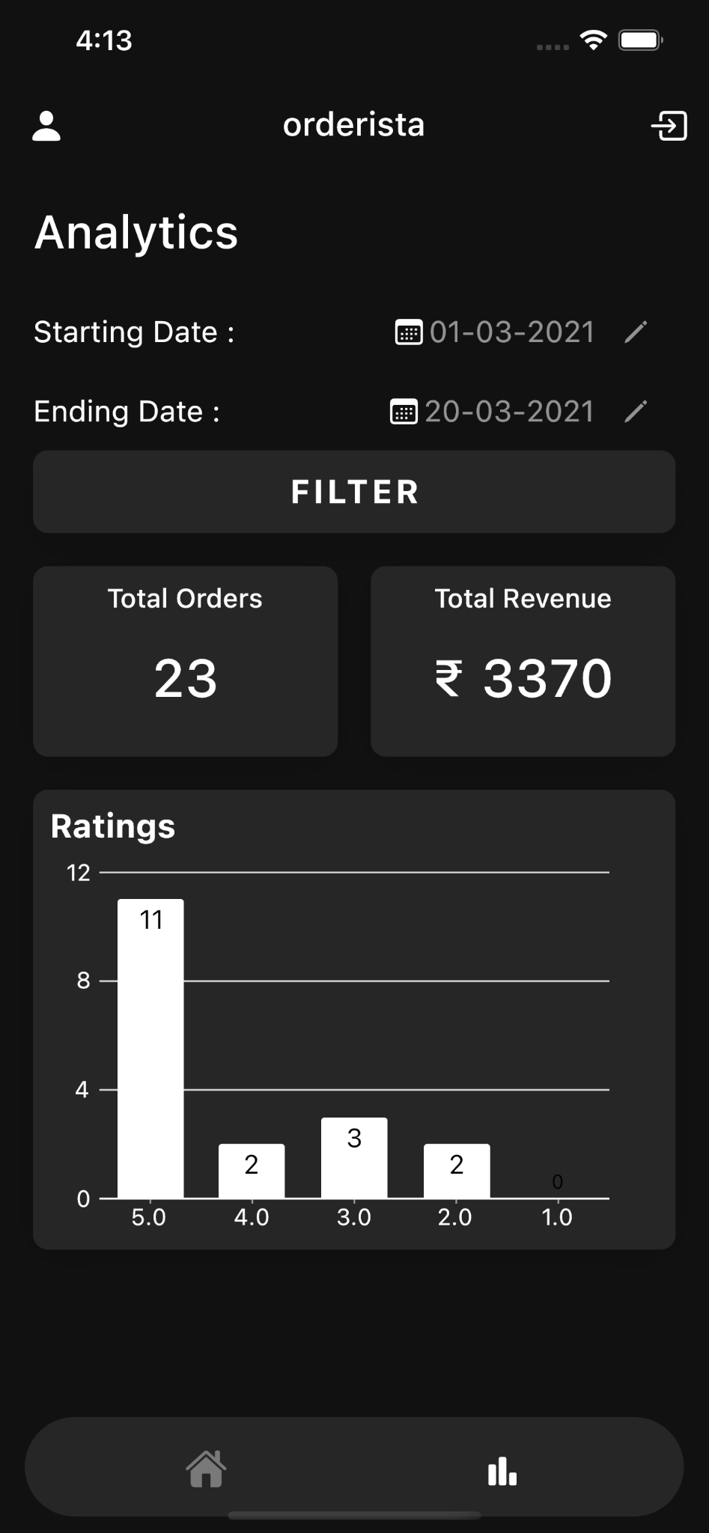
CO-Analysis page AdminAnalysis Page User profile page

Slide 23
5. Conclusion and Future Scope
We would like to conclude on presenting our project Orderista which ensures on enabling the end user to register online, select the food they plan to have for their lunch from e-menu card and place a order online by just selecting the food that the user wants using the application.The system mainly will be aiming to reduce the load on the canteens end, as the entire process of taking orders and serving is automated. It also aims at contributing for a better environment as it Digitalizes every aspect of the data for better analytics.

Slide 24
References
[1] https://en.wikipedia.org
[2] www.google.com
[3] https://www.freeprojectz.com/project-report/1778
[4] https://www.studentprojectguide.com/php/online-foo
d-ordering-system
[5] http://career.infotechmantra.com/project/Canteen_Au
tomation_System.PDF
[6] https://www.ijitee.org/wp-content/uploads/papers/v9i
7/G5095059720.pdf `

Slide 25
Paper Publication
IEEE International Conference on Artificial Intelligence and Smart Systems
(ICAIS 2021)

Slide 26
Thank You

